Slide 1
Intro to VAE
Group U8: Lake Yin, Zhiqi Wang

Slide 2
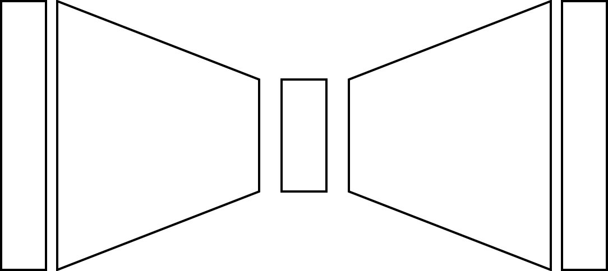




Recap on Autoencoder
$$x$$
$$\hat{x}$$
$x$is the input
$z$is latent representation of $x$ the network learns
$\hat{x}$ is the reconstruction from $x$
$$z$$

Slide 3
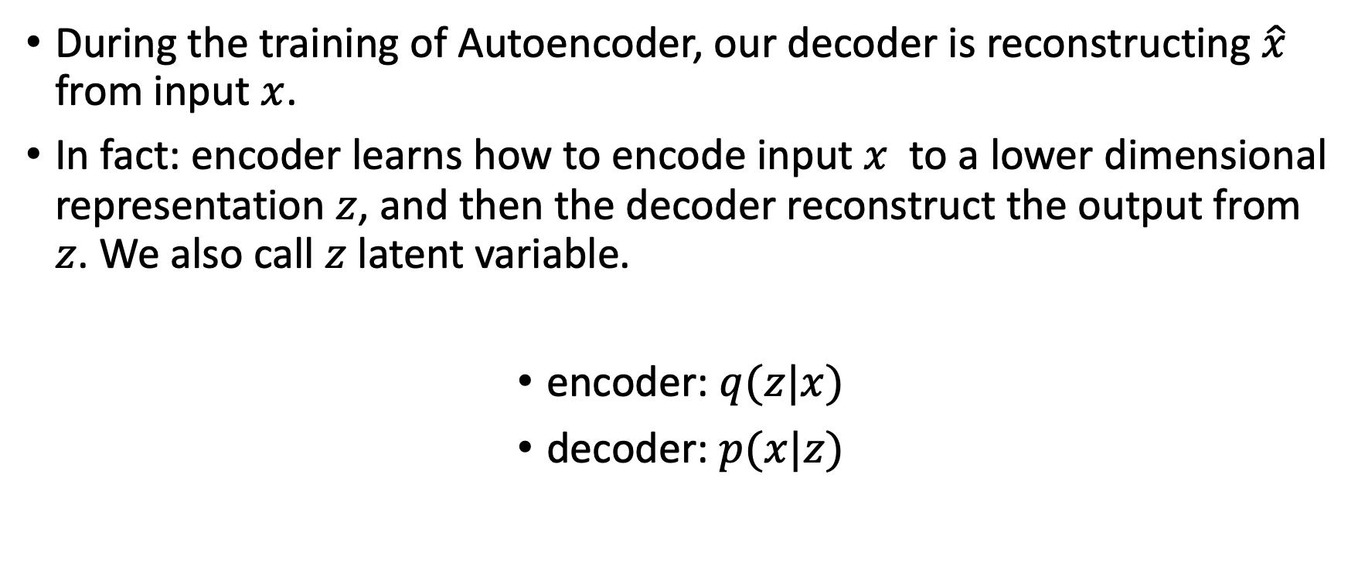
Latent Variable
During the training of Autoencoder, our decoder is reconstructing $\hat{x}$ from input $x$.
In fact: encoder learns how to encode input $x$ to a lower dimensional representation $z$, and then the decoder reconstruct the output from $z$. We also call $z$ latent variable.
encoder: $q(z|x)$
decoder: $p(x|z)$

Slide 4


Recap on Autoencoder
$$x$$
$$\hat{x}$$
$x$is the input
$z$is latent representation of $x$ the network learns
$\hat{x}$ is the reconstruction from $x$
$$z$$
encoder: $q(z|x)$
decoder: $p(x|z)$

Slide 5
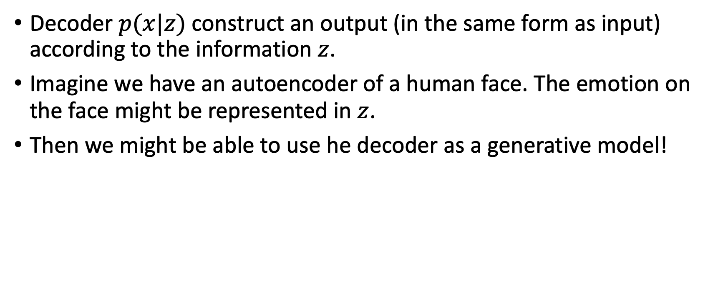
Decoder As a Generator
Decoder $p(x|z)$ construct an output (in the same form as input) according to the information $z$.
Imagine we have an autoencoder of a human face. The emotion on the face might be represented in $z$.
Then we might be able to use he decoder as a generative model!

Slide 6
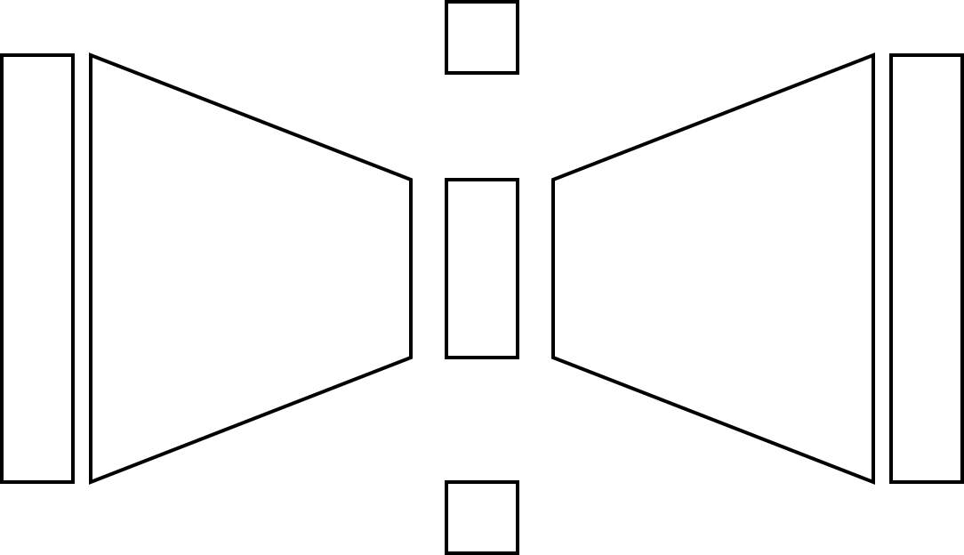


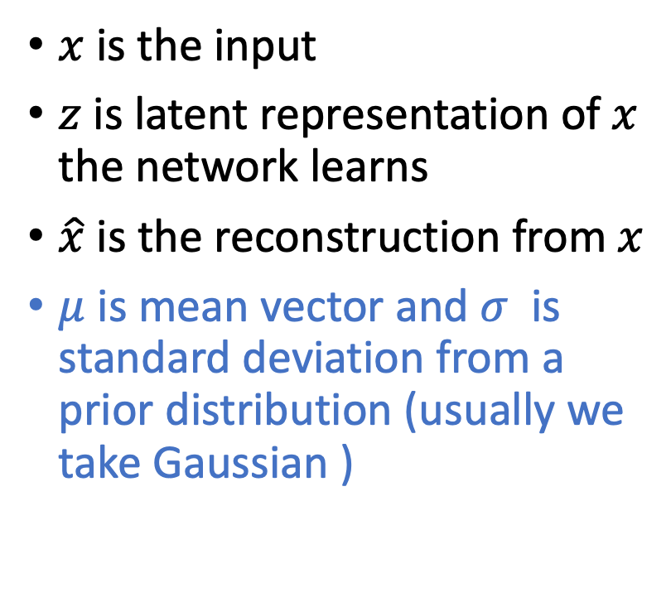


From Autoencoder to VAE
$μ$ – mean vector
$$x$$
$$\hat{x}$$
$x$is the input
$z$is latent representation of $x$ the network learns
$\hat{x}$ is the reconstruction from $x$
$μ$ is mean vector and $σ$ is standard deviation from a prior distribution (usually we take Gaussian )
$$z$$
encoder: $q_{φ}(z|x)$
decoder: $p_{θ}(x|z)$
$σ$– standard deviation

Slide 7
VAE’s Objective Function

